Slide 1
Video Understanding
Sanmathi Kamath
Pranjali Kokare
Alekhya Munagala

Slide 2
Introduction
Rapid consumption of videos everyday
People watch over 1 billion hours of video every single day on Youtube
Understanding videos can be useful for:
Automatic tagging of new videos
Easy video retrieval/search
Video recommendation

Slide 3
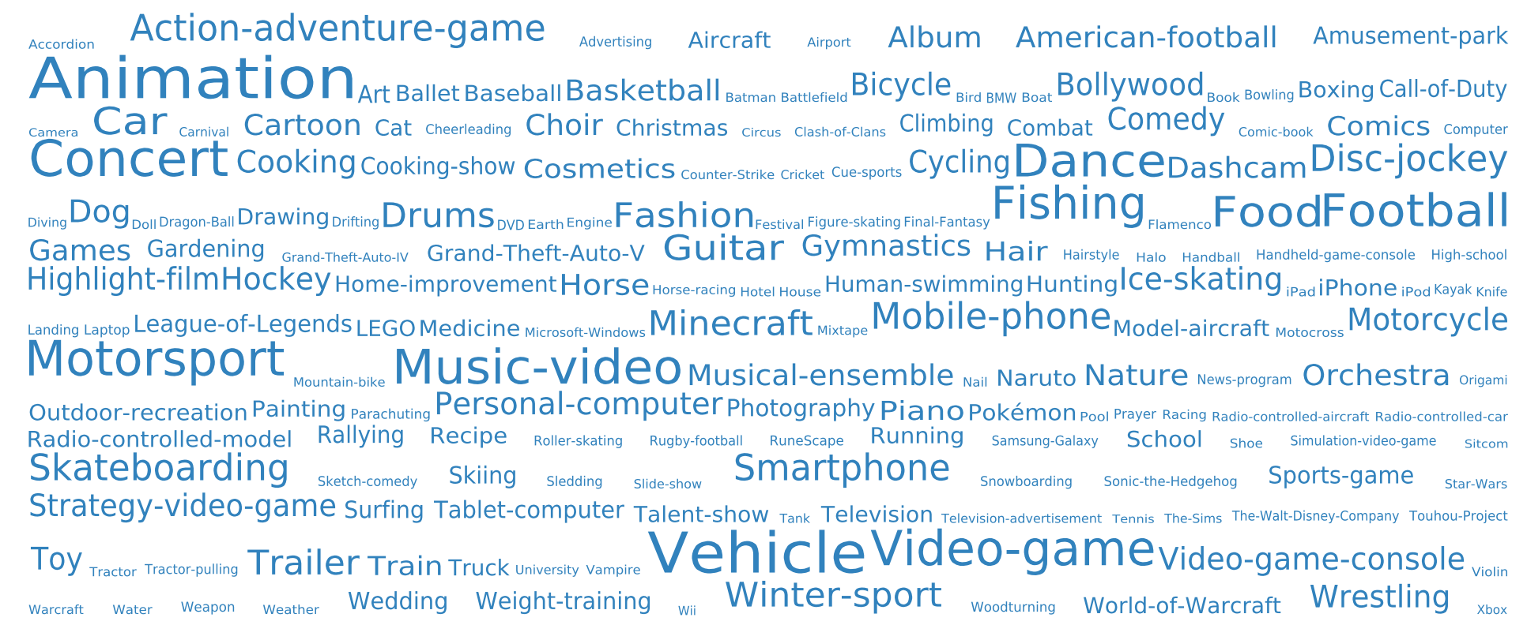
Problem Statement
Building a compact model for Large-scale video understanding
The main goal is to predict multiple labels/categories for each video

Slide 4
Celebration, Birthday, Blowing Candles, Cake

Slide 5
Why is it challenging?
Annotating videos manually is much more time-consuming and noise-prone than images.
Storing and processing videos is computationally expensive.
Developing a generic classification model is difficult as most video datasets are confined to certain themes (sports, education etc).
Information in videos is temporally distributed.

Slide 6
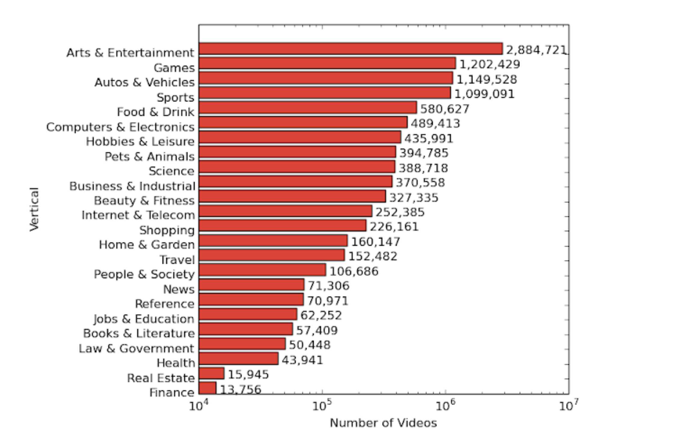
DataSet
YouTube-8M: A Large-Scale Video Classification Dataset:
~ 8 Million Videos
~ 1.9 Billion Video Frames
~ 500K hours of video
Annotated with Visual Vocabulary of 4800 visual entities
Each video is between 100 to 500 seconds long

Slide 7
Our Approach
Frame-level model:
Frame level classification + Average pooling
Video-level model:
Including the temporal information
Building a classification neural network to predict probabilities across all labels
Choose top K-labels

Slide 8
Evaluation
Hit@k:
Fraction of test samples that contain at least one of the ground truth labels in the top k predictions.
Global Average Precision (GAP):
K(=20) features with highest confidence scores are accessed and average global precision is computed as follows:
GAP=∑p(i)Δr(i)
p(i) = precision, r(i) = recall

Slide 9
Resources
Software | PyTorch
Hardware/Cloud | Google colab, Google cloud, GPU Cluster
Dataset | Youtube 8M Challenge

Slide 10
Goals and Action Plan
75%
Data Analysis and Pre-processing.
Review and analyze existing model architectures.
Implementing Frame-level Model.
100%
Researching and Implementing Video-level model .
Analysis and Evaluation of the implemented methods.
125%
Analyzing the weights learnt by deep neural network to explore the idea of using traditional machine learning models.
Evaluating the tradeoffs between model architecture and performance.

Slide 11
References
Sami Abu-El-Haija, Nisarg Kothari, Joonseok Lee, Paul Natsev, George Toderici, Balakrishnan Varadarajan, Sudheendra Vijayanarasimhan, “YouTube-8M: A Large-Scale Video Classification Benchmark”, arXiv:1609.08675
https://www.kaggle.com/c/youtube8m/overview
Duarte, K., Rawat, Y., & Shah, M. (2018). “VideoCapsuleNet: A simplified network for action detection. In Advances in Neural Information Processing Systems” (pp. 7610-7619)
Lin, R., Xiao, J., & Fan, J. (2018). “NextVLAD: An efficient neural network to aggregate frame-level features for large-scale video classification.” In Proceedings of the European Conference on Computer Vision (ECCV) (pp. 0-0).

